Slide 1

Crop Cutting Experiment (CCE) Agri app Version 1.3.55
- User Guide
Pradhan Mantri Fasal Bima Yojana (PMFBY)
Department of Agriculture and Farmers Welfare,
Ministry of Agriculture and Farmers Welfare,
Government of India
New Delhi

Slide 2

About CCE.
Crop Cutting Experiments or CCEs, refer to an assessment method employed by governments and agricultural bodies to accurately estimate the yield of a crop or region during a given cultivation cycle, and is known by different names in different regions.
The traditional method of CCE is based on the yield component method where specific locations are selected based on a random sampling of the total area under study. Once the plots are selected, the produce from a section of these plots is harvested and analyzed for a number of parameters such as biomass weight, grain weight, moisture, and other indicative factors.
The data gathered from this study is extrapolated to the entire region and provides an approximate assessment of the average yield of the state or region under study.

Slide 3
Objectives of use of CCE Agri app
Capturing and uploading of real time Crop Cutting Experiment (CCE) data on National Crop Insurance Portal (NCIP)
To Capture geo-coordinates of CCE plot
Uploading of CCE data with Photographs
Reduce moral hazards
Timely settlement of yield-based claims

Slide 4
Users of CCE Agri app under PMFBY scheme
State Government (Primary workers assigned by State Govt uses CCE Agri app)
State Agricultural Statistics Authority (SASA) in each State/Union Territory is the nodal agency/authority for CCE planning. Further, it also looks after training of field staff, organization of field work and tabulation of data for report submission
Example-
Agriculture Department
Economics and Statistics Department
Revenue Department etc
Insurance company (Field Staff assigned by insurance companies uses co-observe app)
Insurance agents provide validation number against each CCE experiment number to Primary worker which is generated through co-observe app . Insurance agents have option to raise objection against each CCE

Slide 5
Methods of conducting CCEs under PMFBY
Crop Cutting Experiments or CCEs, refer to an assessment method employed by governments and agricultural bodies to accurately estimate the yield of a crop or region during a given cultivation cycle, and is known by different names in different regions
Currently, two methods are followed for selection of survey number and field for conducting CCEs under PMFBY.
A] Random Sampling Method (Traditional):
The randomized selection of CCE fields is carried out on the basis of GCES plan prepared by respective SASAs for the ensuing agricultural year.
B] Smart Sampling Technique (SST) method: In this method, CCE fields are selected using remote sensing strata based on the crop health.

Slide 6
Content
How to install CCE Agri App from play store.
Change Language of CCE APP
Registration of User’s
Role of District CCE Admin for User’s Registration.
Capturing of CCE data in CCE Agri app and Uploading of CCE data
Role of Co – Observer
District CCE User Role (Approve / Reject)
CCE Report
State wise status of Planned CCEs and CCEs uploaded using CCE Agri app during the year 2022-23

Slide 7
How to install CCE Agri App from play store.

Slide 8
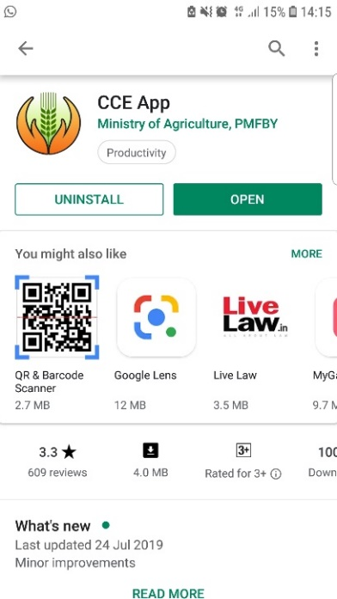
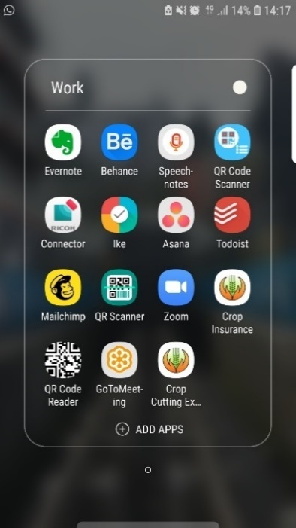
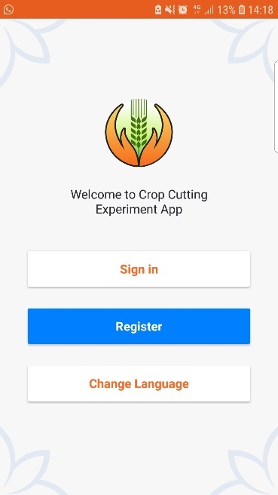
How to install CCE Agri App from play store.
Search the CCE Agri app in Play Store in your mobile and Install it.

Slide 9
Change Language of CCE APP

Slide 10
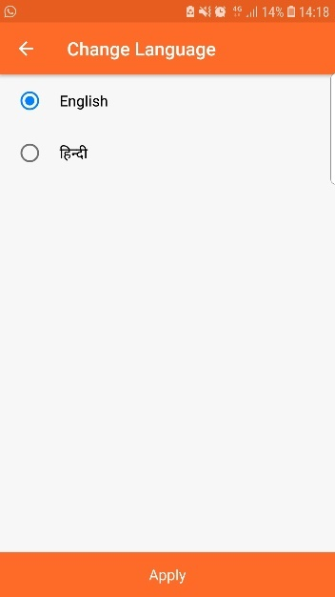
Change Language of CCE APP
Click on change language to switch the language
Click apply button to change the language

Slide 11
Registration of User’s

Slide 12
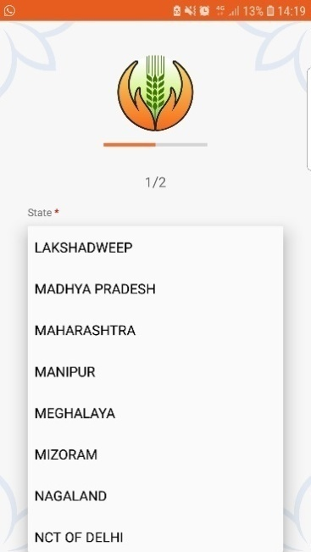
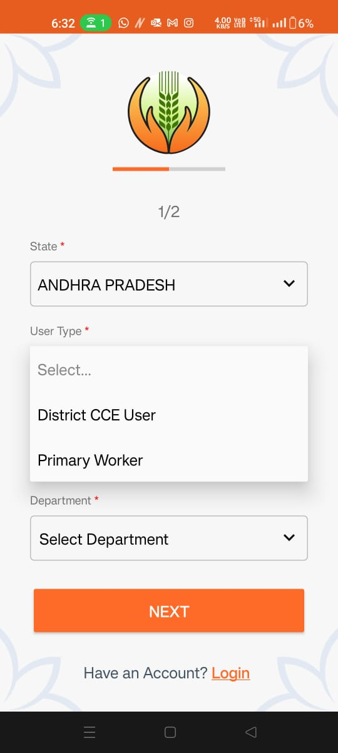
Registration of User’s
Click on register button
Select state
Select user type

Slide 13
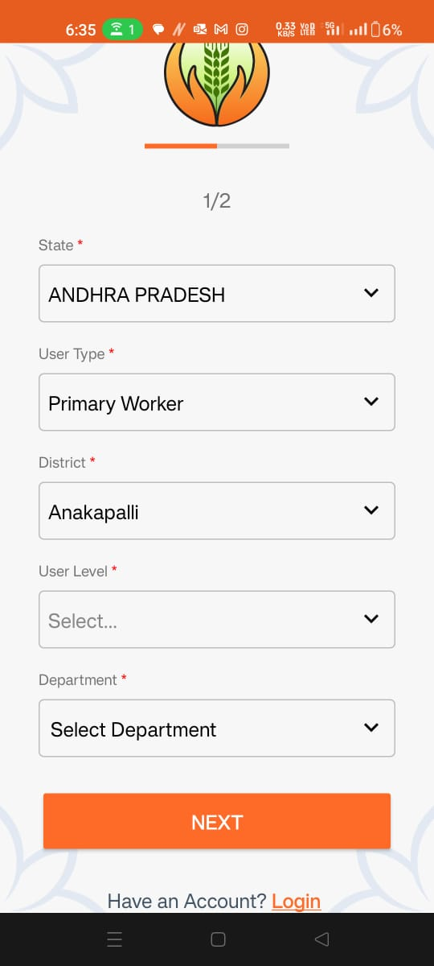
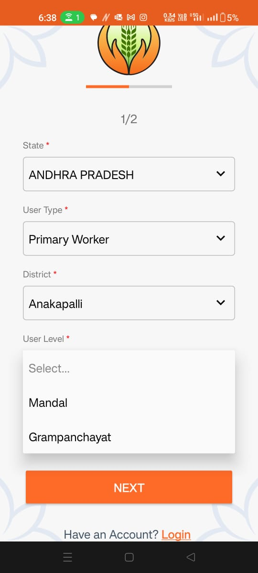
Registration of User’s
Select district
Select User Level

Slide 14
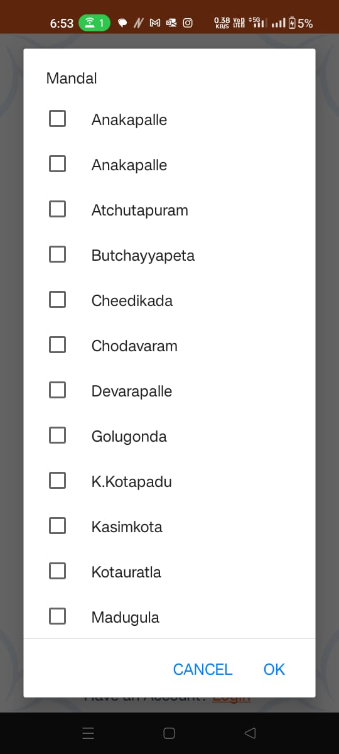
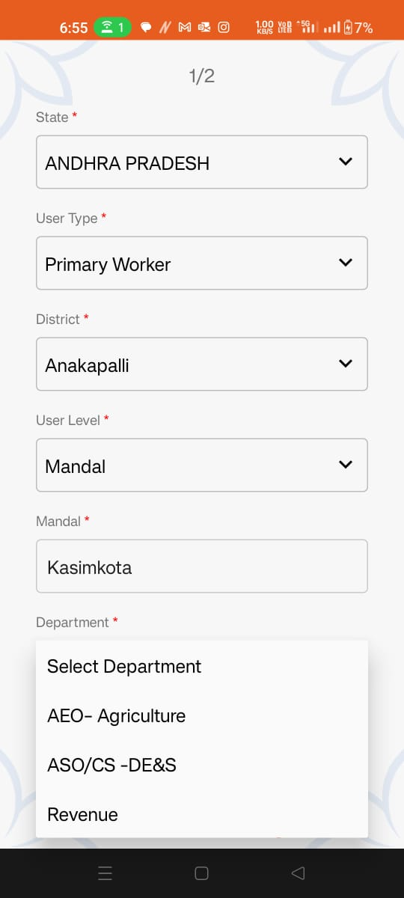
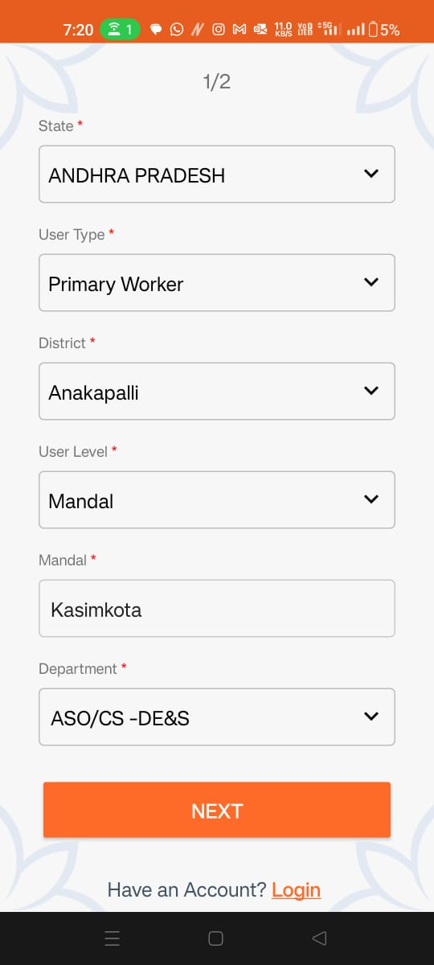
Registration of User’s
Select Mandal/Block
Select Department
Click on Next

Slide 15
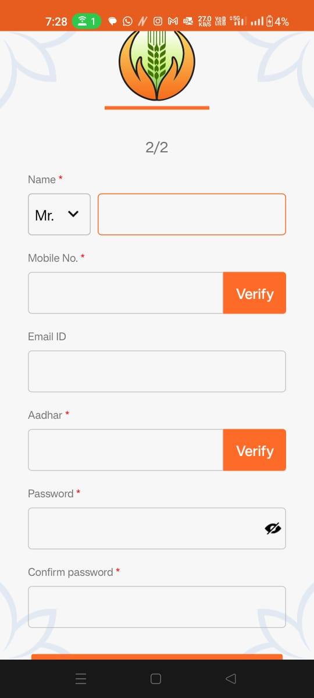
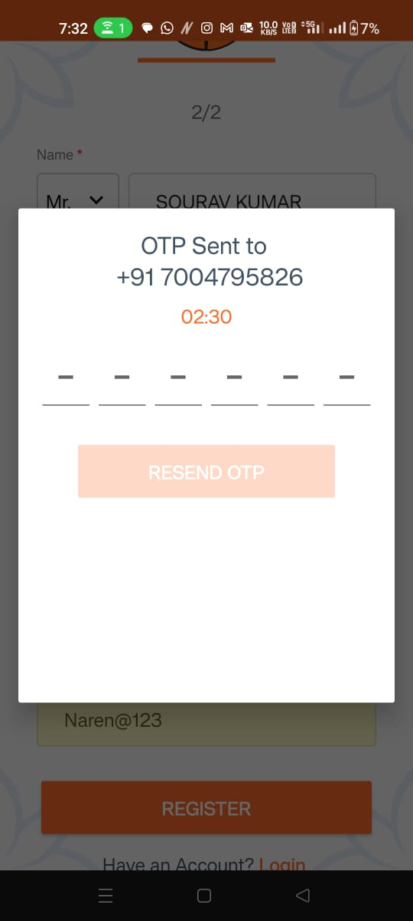
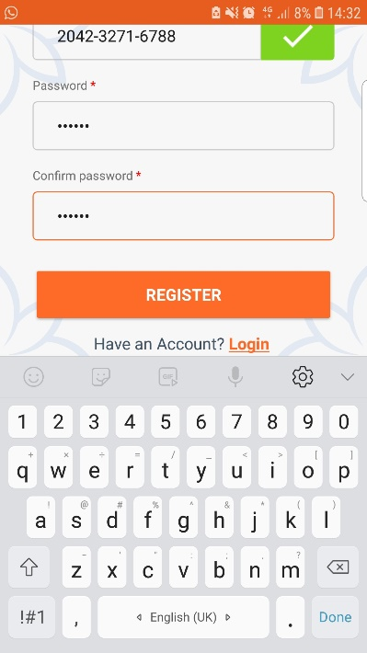
Registration of User’s
Fill the required details and verify your mobile and Aadhar number
Verify mobile number and Aadhar number on your registered mobile number with OTP
Click on register

Slide 16
Role of District CCE Admin for User’s Registration.

Slide 17
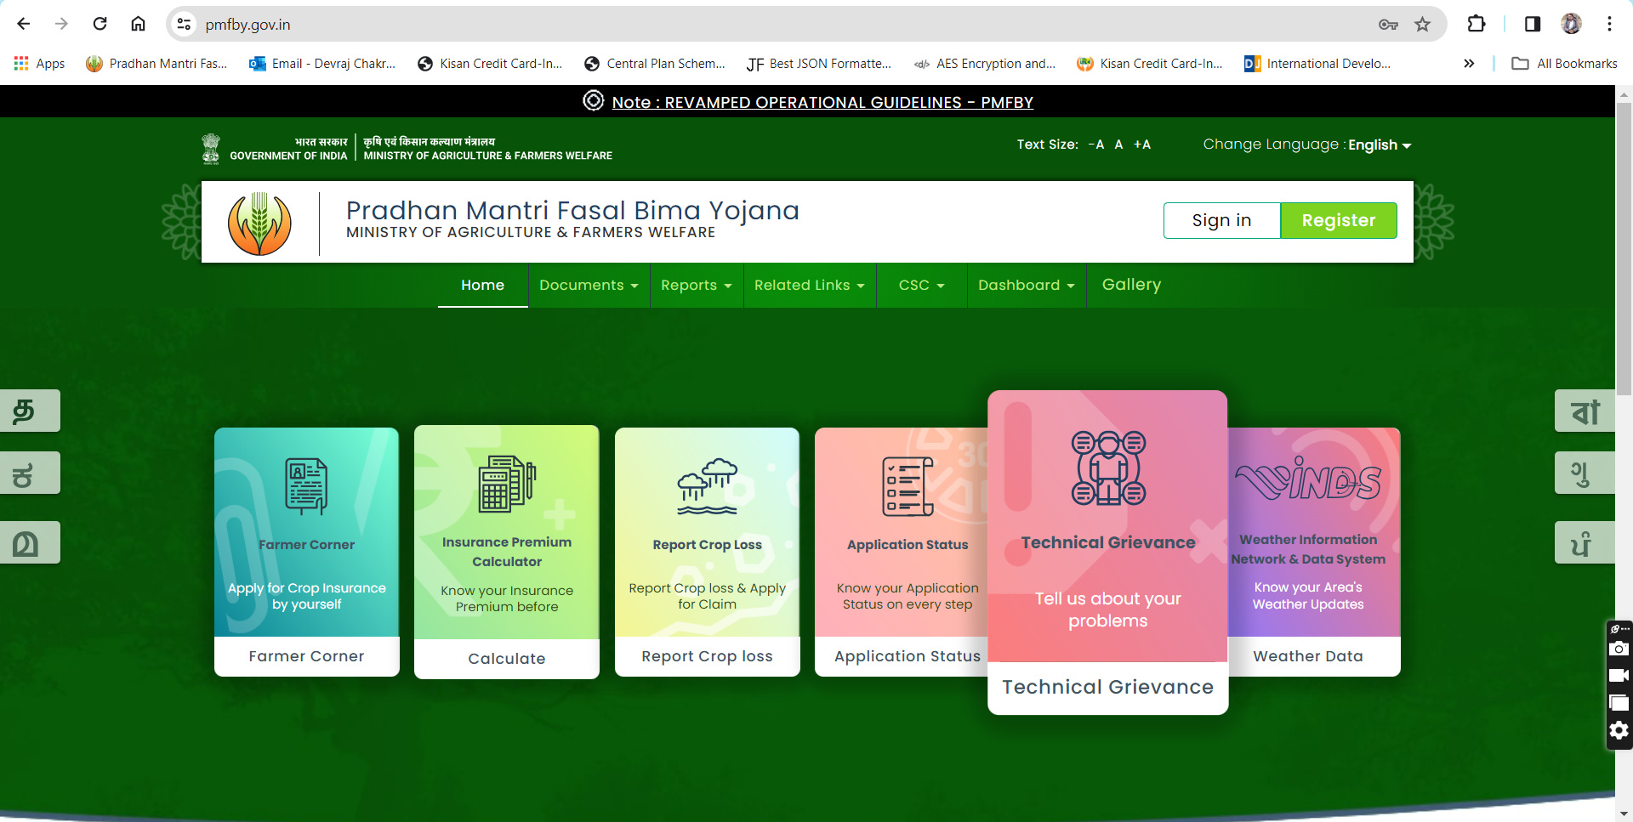
Role of District CCE Admin for User’s Registration.
The District CCE admin first log on to PMFBY portal for registering the primary worker.
For login into PMFBY portal go to the link https://pmfby.gov.in/ then click on Sign in.

Slide 18
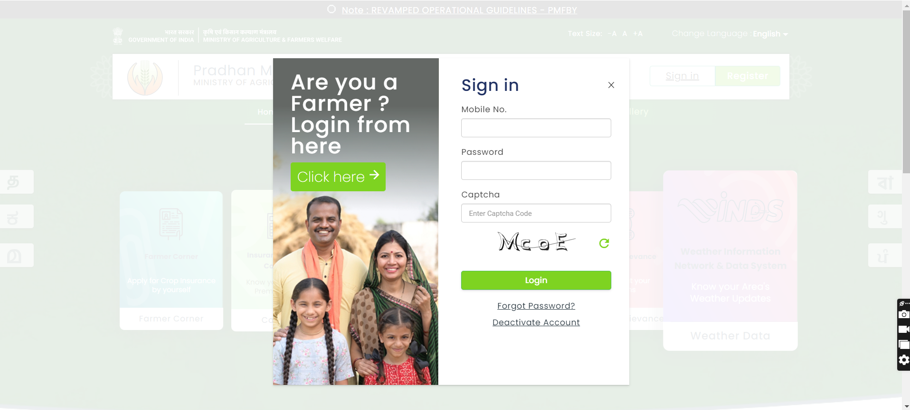
Role of District CCE Admin for User’s Registration.
A Login page will appear on the screen, with Sign in option in right side for District CCE User.
Enter mobile No, password and verification captcha code and click on Login

Slide 19
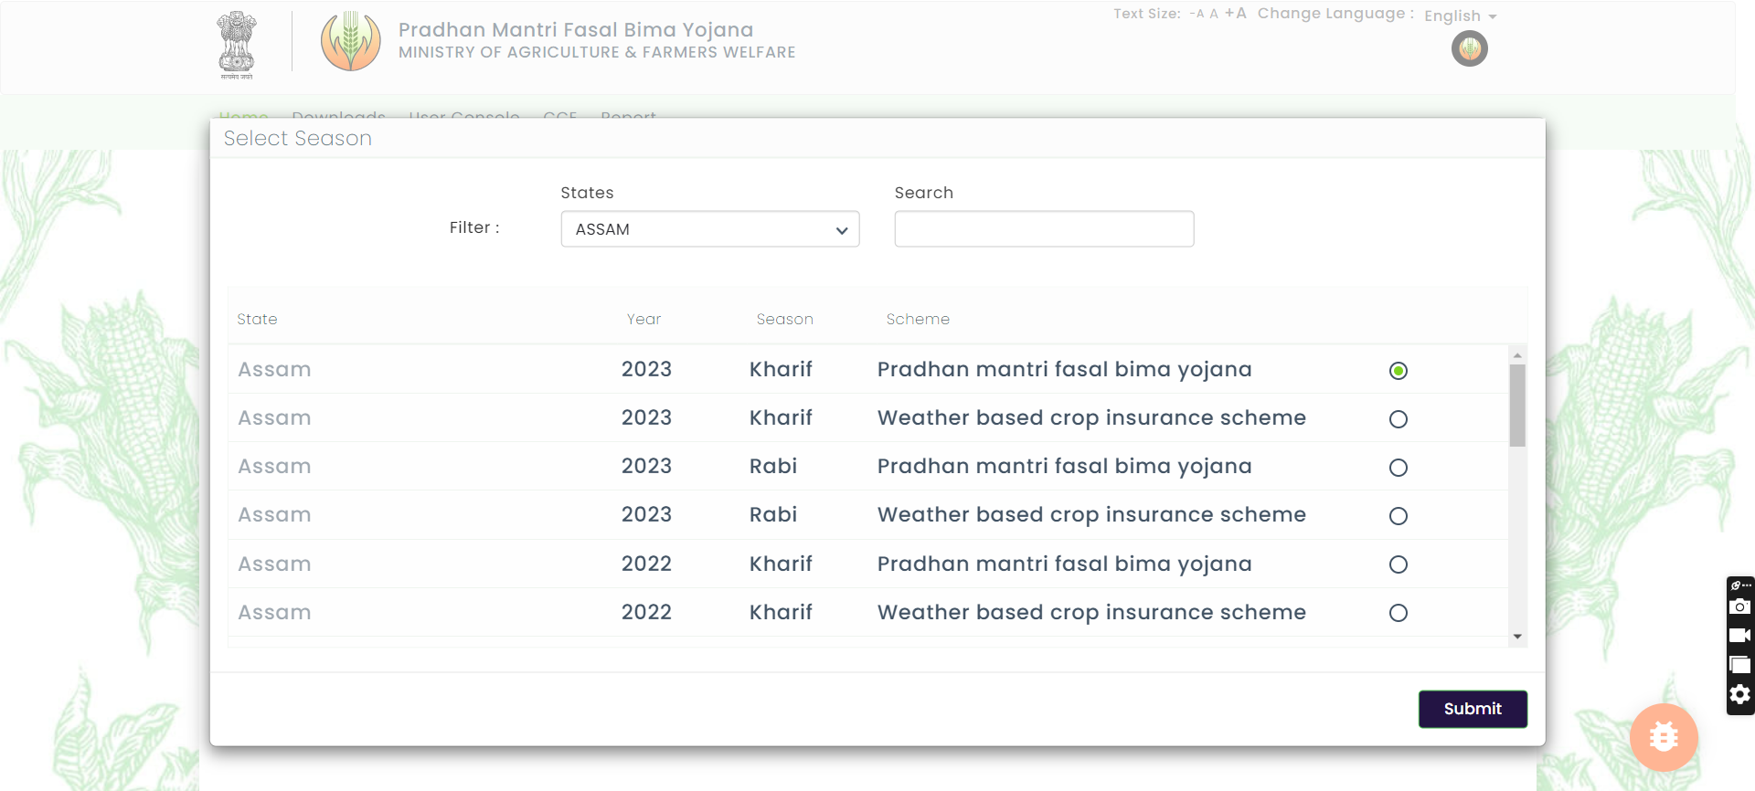
Role of District CCE Admin for User’s Registration.
After login to portal Select Year, Season and Scheme and submit.

Slide 20
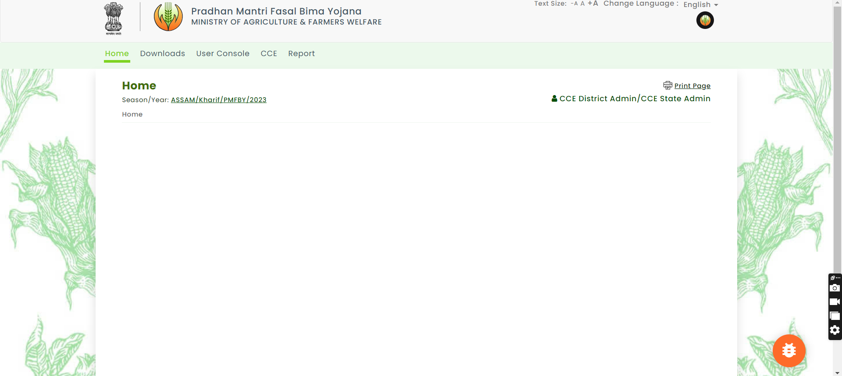
Role of District CCE Admin for User’s Registration.
After login go to user console

Slide 21
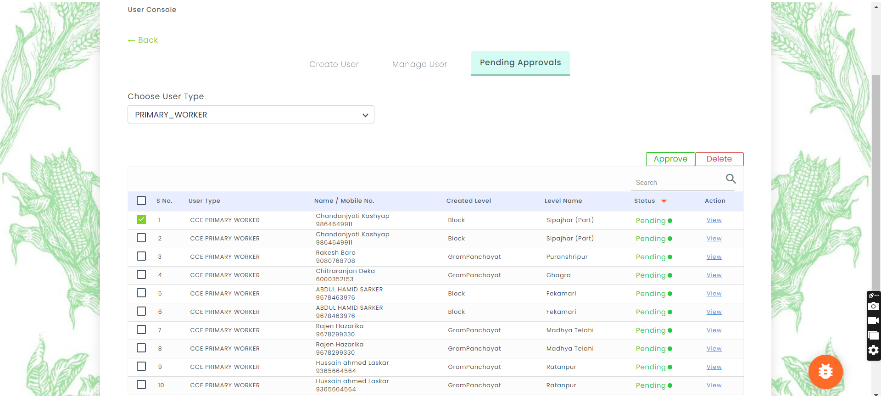
Role of District CCE Admin for User’s Registration.
Click on pending approvals
Select the user
Click on approve

Slide 22
Capturing of CCE data in CCE Agri app and Uploading of CCE data

Slide 23
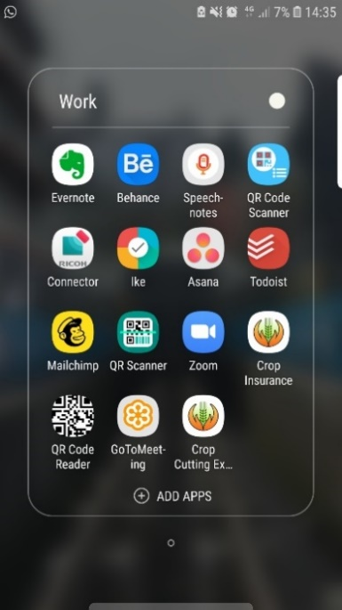
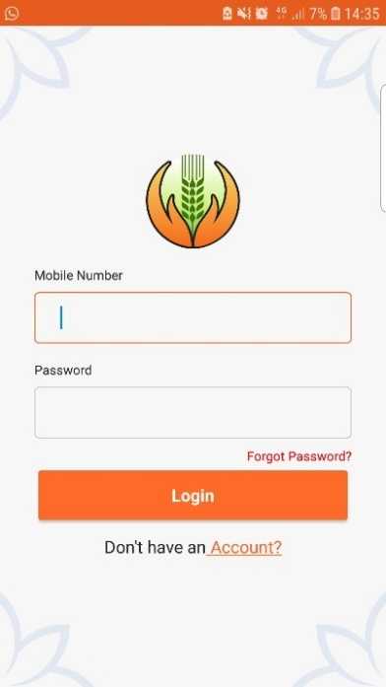
Capturing of CCE data in CCE Agri app and Uploading of CCE data
Click on CCE app installed in your phone
Home Screen
Enter login ID & Password

Slide 24
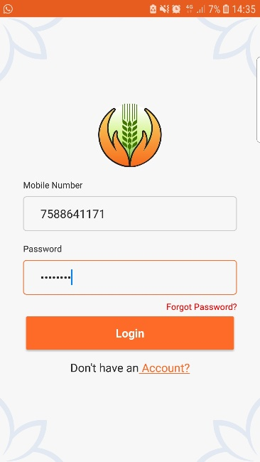
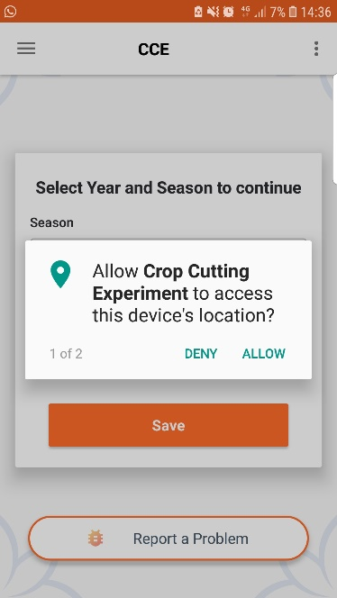
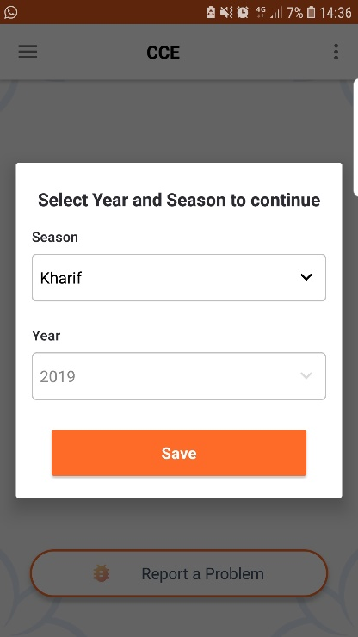
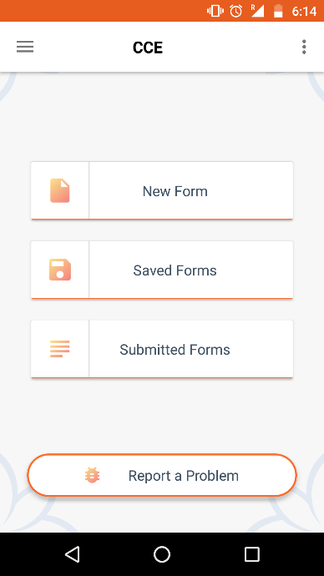
Capturing of CCE data in CCE Agri app and Uploading of CCE data
For login into CCE Agri app enter your mobile number and password and click on Login. for data entry, CCE app asks to allow the access of device location and photo, media and files. Click on Allow. Select Season and Year and click on save button

Slide 25
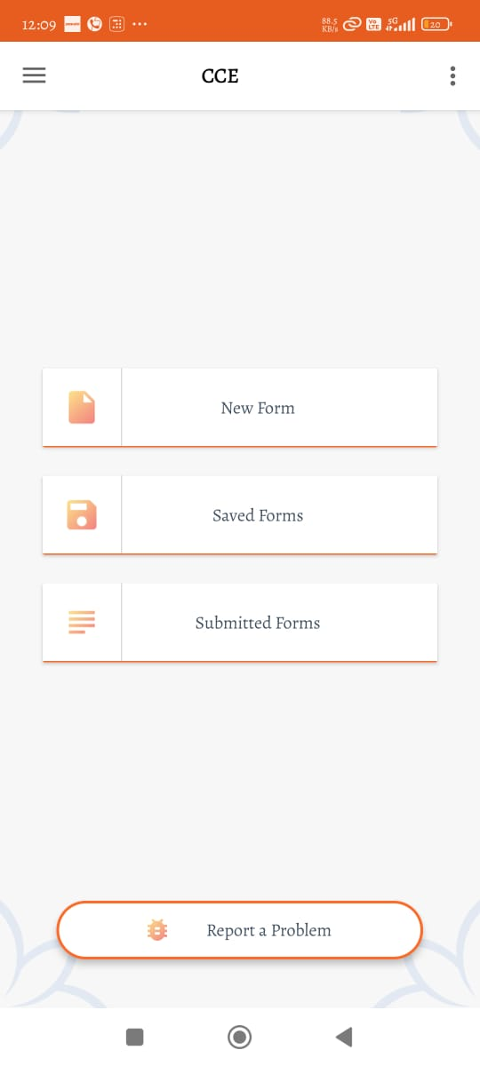
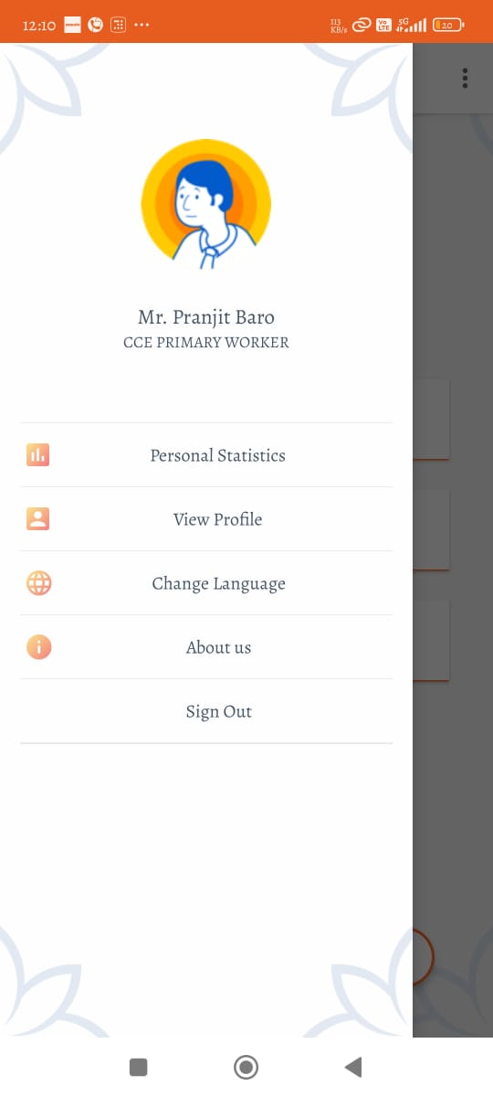
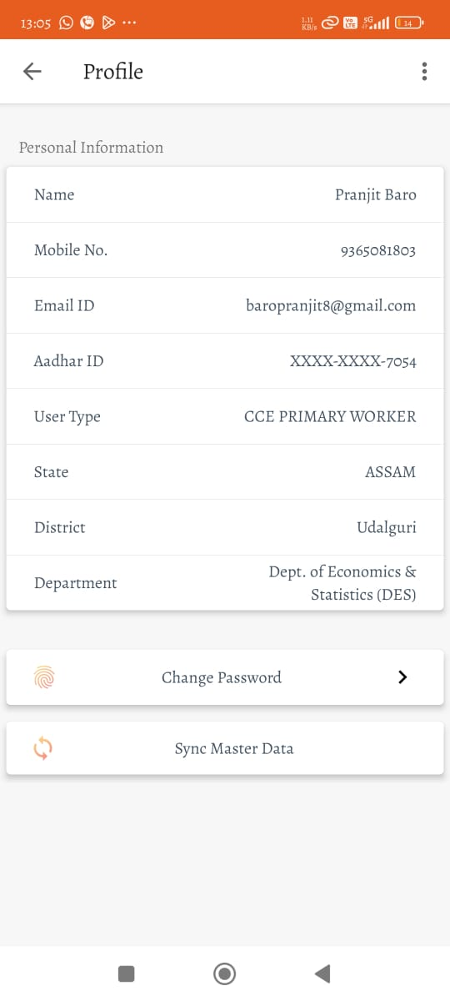
View Profile and Sync Master Data
Before starting the CCE activity, the user needs to sync the master data when internet connectivity is available.
to do this, click on the Three horizontal lines of top left corner > go to "View Profile,“> and select "Sync Master Data."

Slide 26
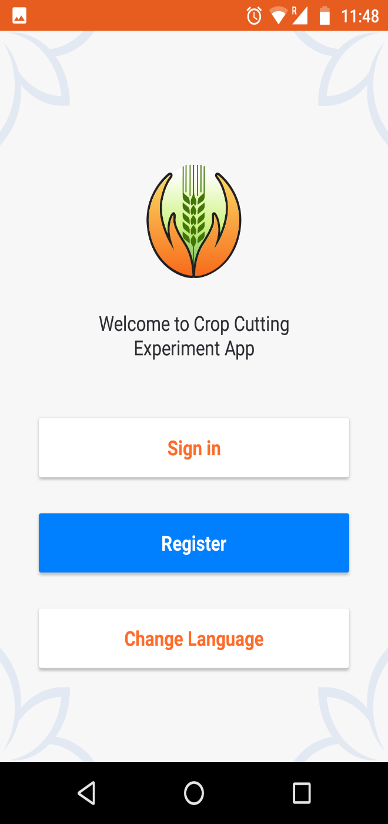

CCE Agri App
Broad Fields of CCE Agri App
  Form Part 1: Planning and selection of survey/sub-survey/CCE plot
  Form Part 2: Capturing of authentic CCE data directly from the field with Geo-tagged photographs.
  CCE Field selection and images
  Crop Specification and images
  Harvest and weighing specifications
  Fertilizer and irrigation details
  Details of supervisors for verification and approval
  Form Part 3: Later Harvest details for capturing dry weight

Slide 27
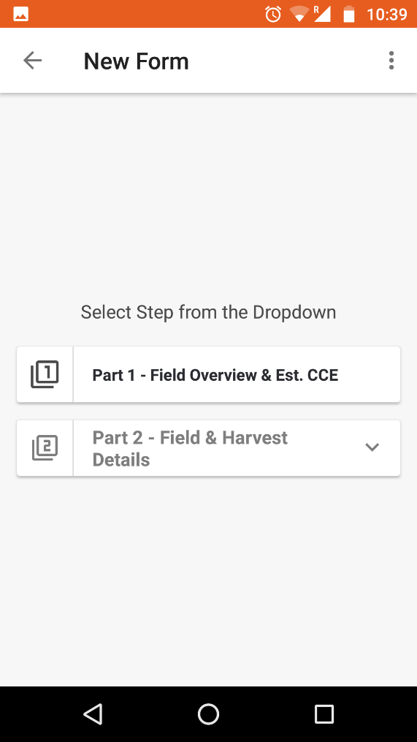
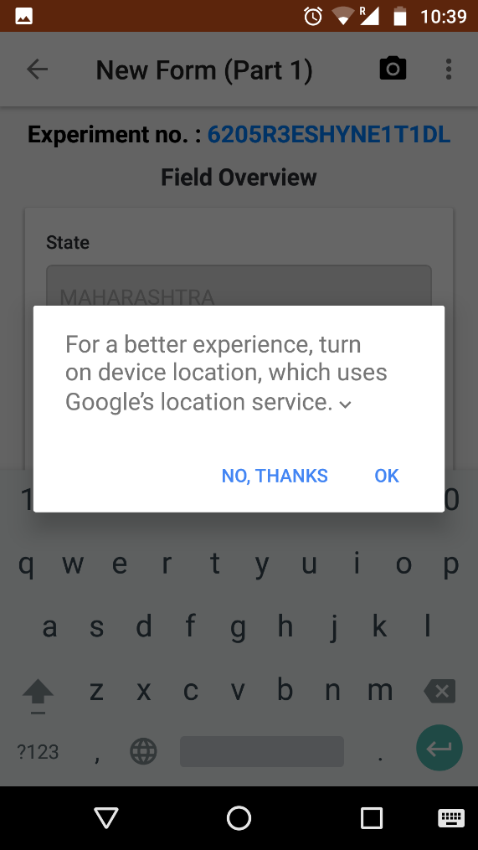
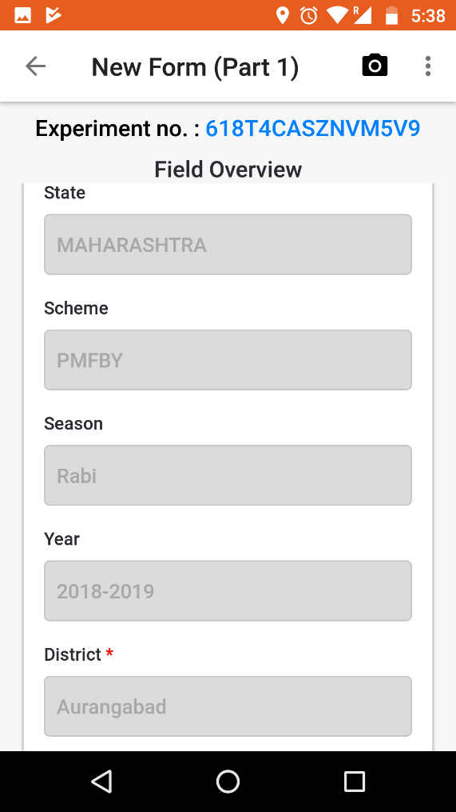
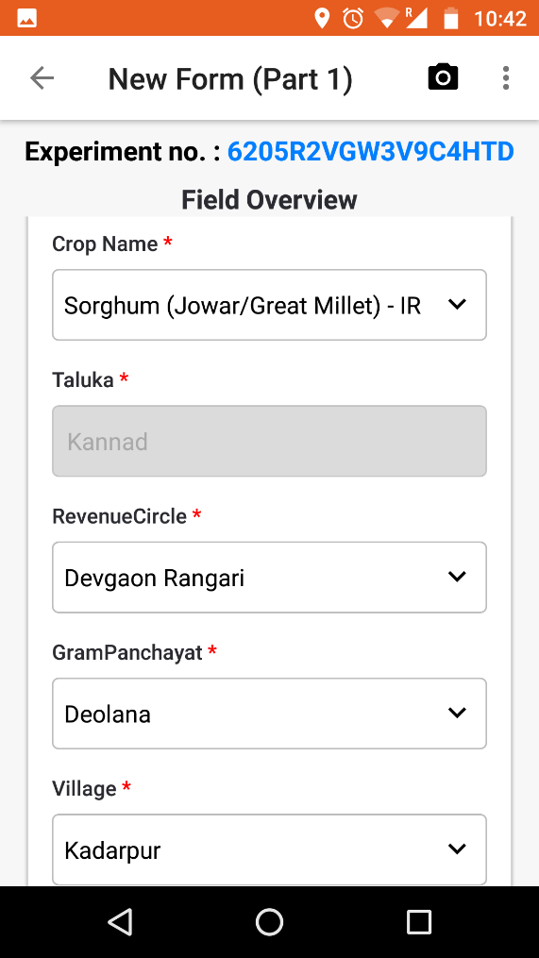
Filling of Part 1 (Form 1)- Field Overview
Fill the field overview details in form

Slide 28
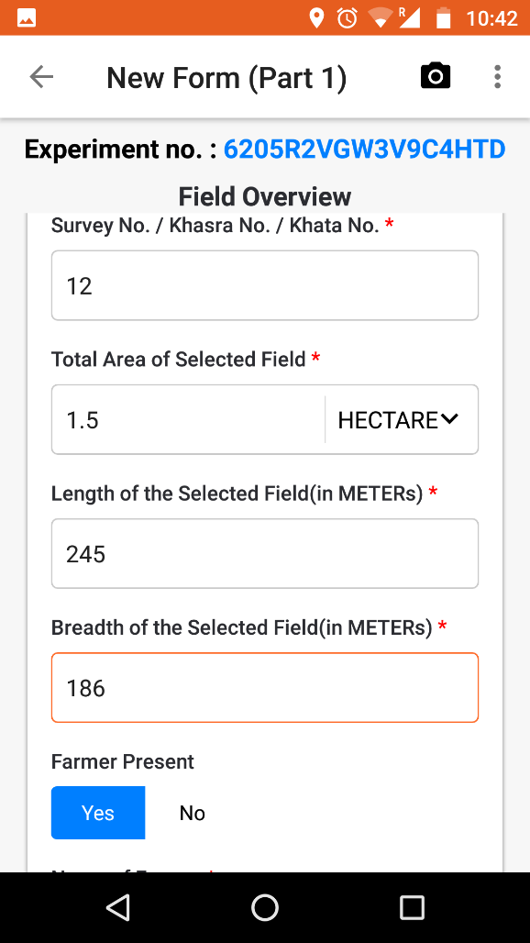
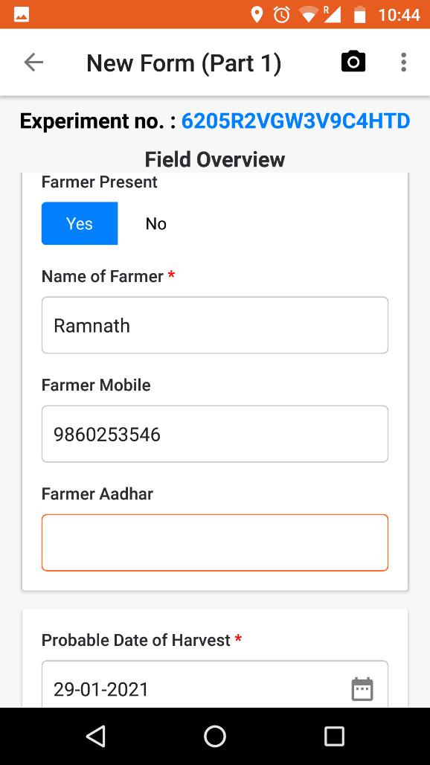
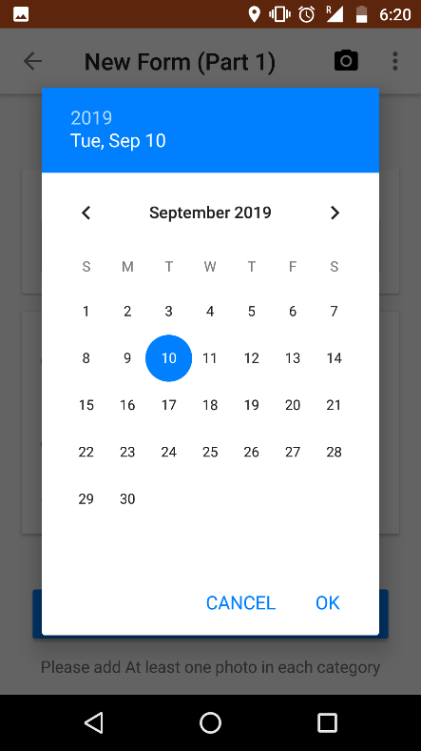
Filling of Part 1 (Form 1)- Field Overview
Then select Yes if the farmer is present there or select No if the farmer is not present on the field at the time of filling Form-1. If the farmer is present enter the Farmer name, his mobile No, Aadhar No. and select the probable date of harvesting of the crop and click on OK.

Slide 29
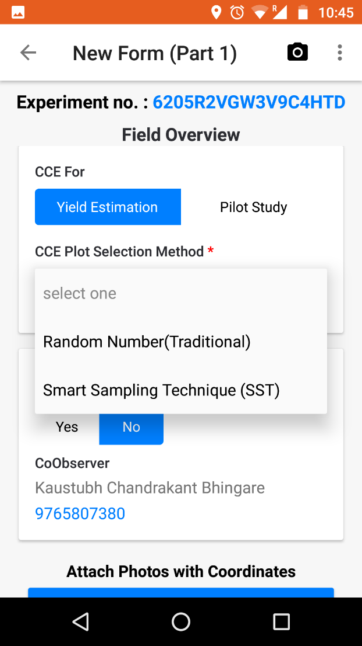
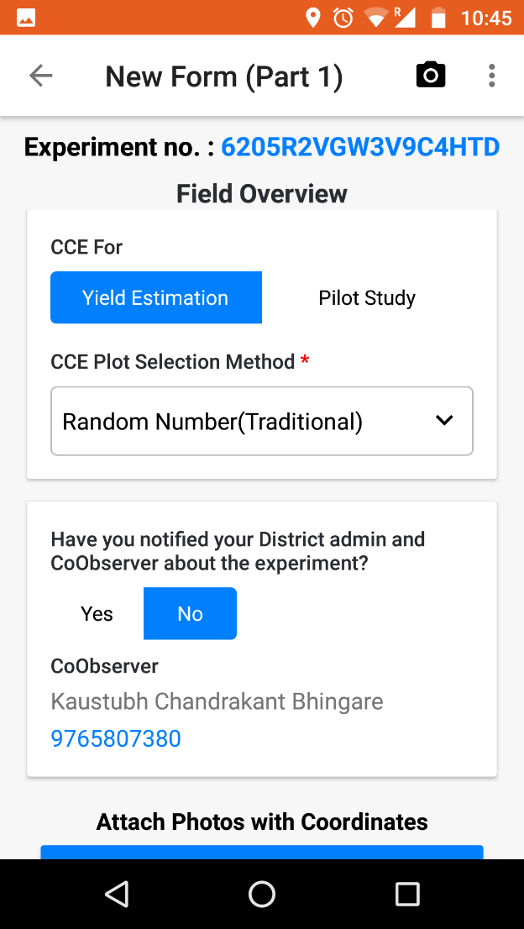

Filling of Part 1 (Form 1)- Field Overview
select the applicable CCE plot selection method “Random Method” or “Smart Sampling Technique” (SST)

Slide 30
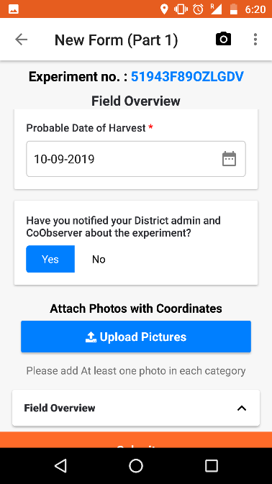
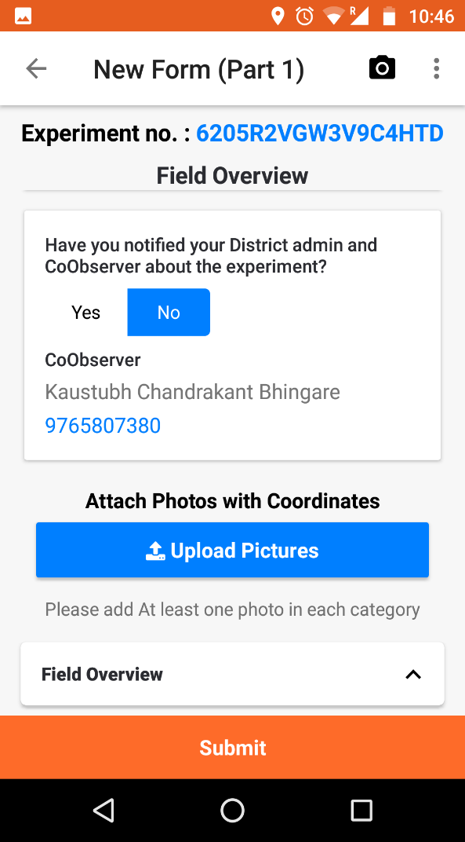
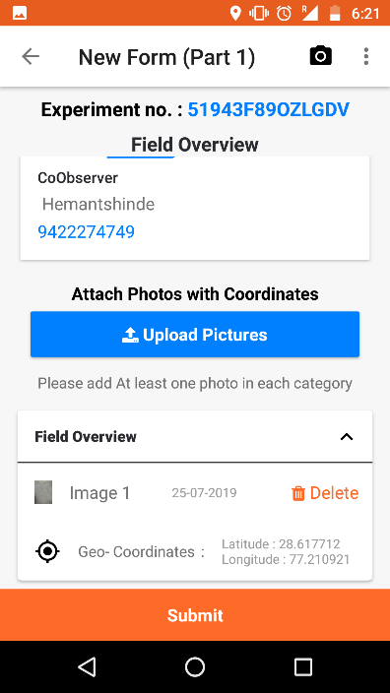
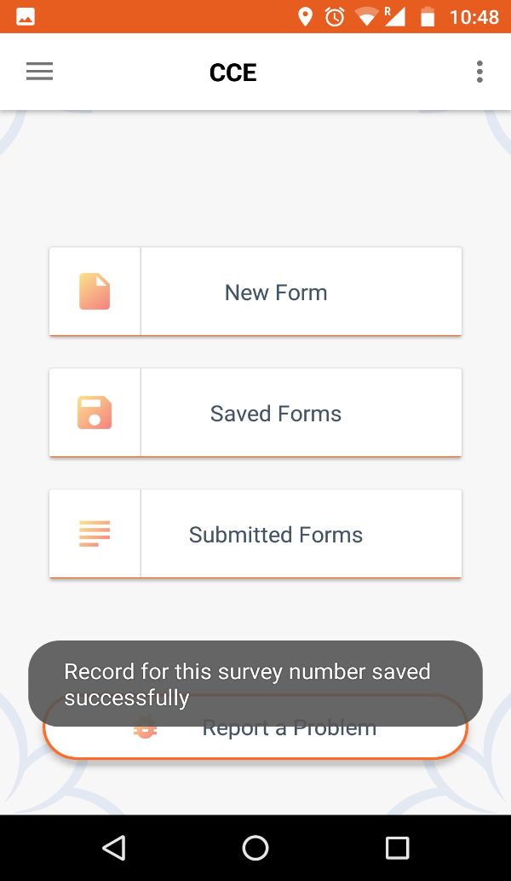
Filling of Part 1 (Form 1)- Field Overview
Select Yes, if you intimated your district admin and Co-observer about the CCE otherwise select No, Upload picture of Field Overview by clicking on Upload Picture and click on Submit. (you can upload up to 3 images in each of the 4 sections during filling of form 1 and 2)

Slide 31
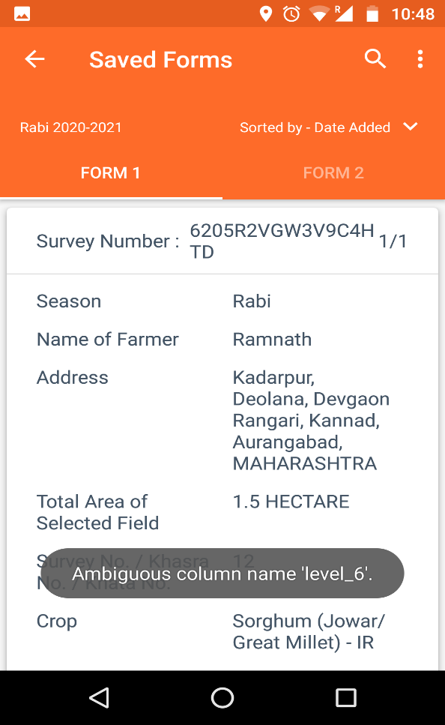
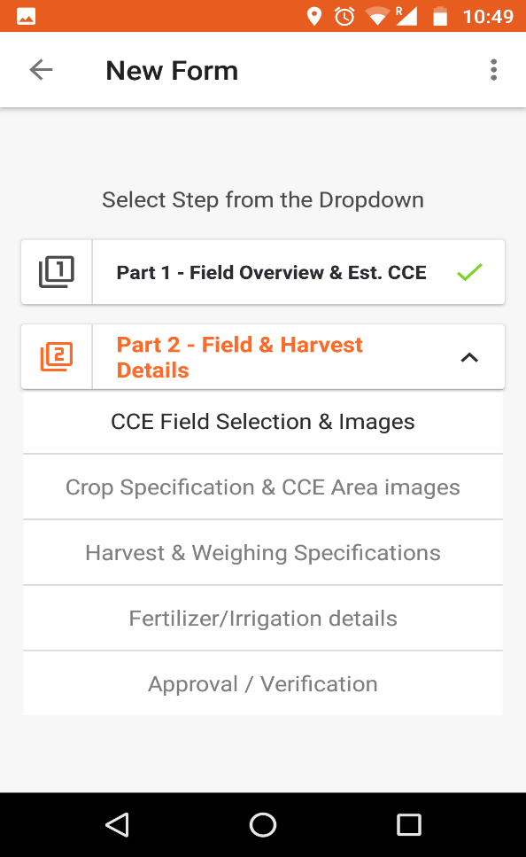
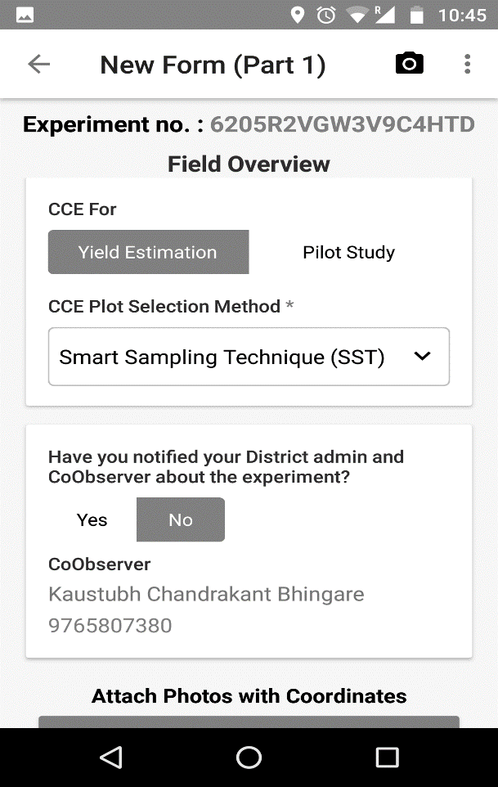
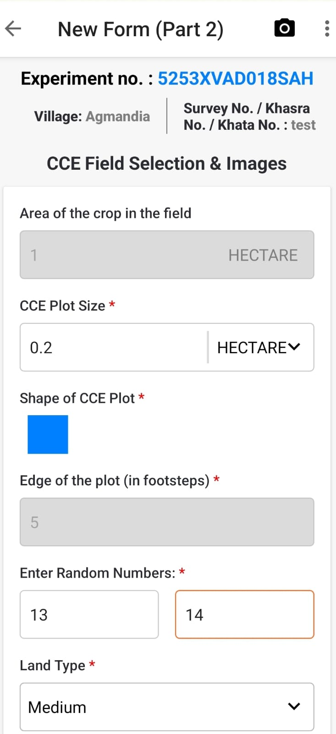
Filling of Part 2 (Form 2)
After Submitting form-1 go back by clicking on back arrow near New Form (Part 1) on upper left side of the screen.
Select Saved Forms option for filling of Part-2 Field and Harvest Details. In Saved Forms option you can see all Saved forms. Click on next for filling of Part 2- Field & Harvest Details.
If the user selects the "SST" method in CCE plot selection during form 1, then "Enter the random number" tab will not appear in form 2, and the user should proceed by entering the "Edge of the field."

Slide 32
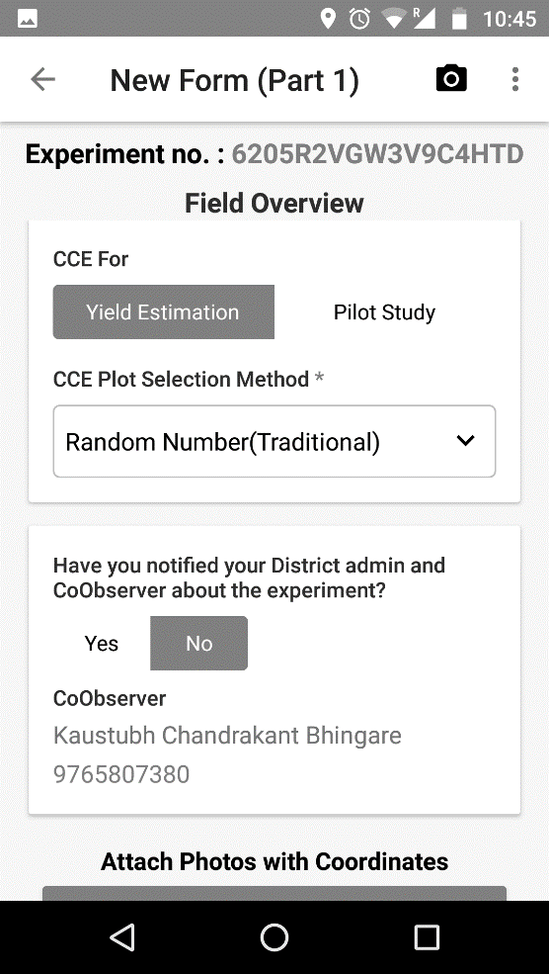
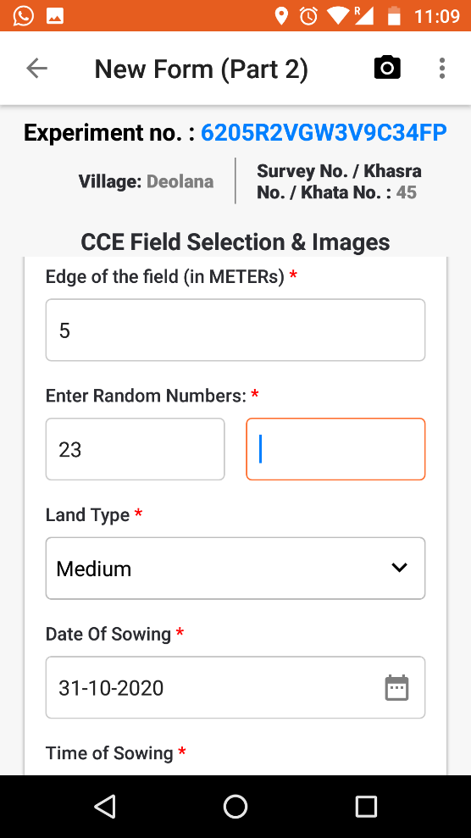
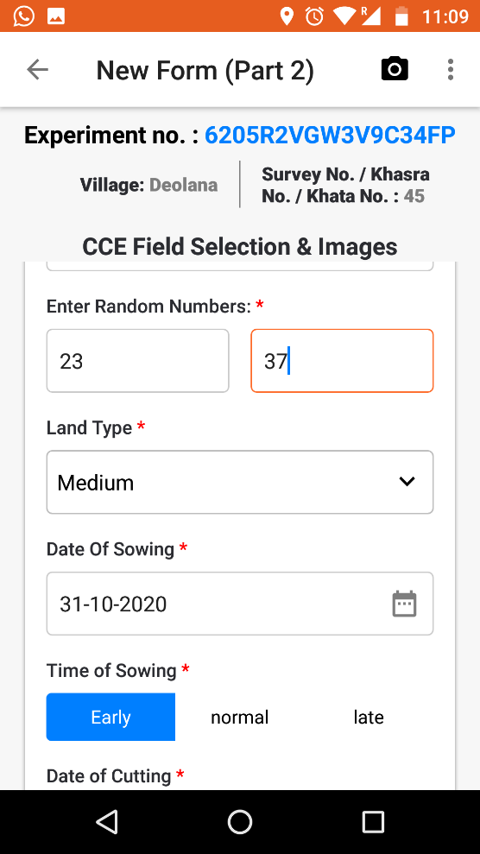
Filling of Part 2 (Form 2)- CCE Field selection
If the user selects the “Random Method“ in CCE plot selection in form 1 , then the need to enter the “Random Number“ in form 2

Slide 33
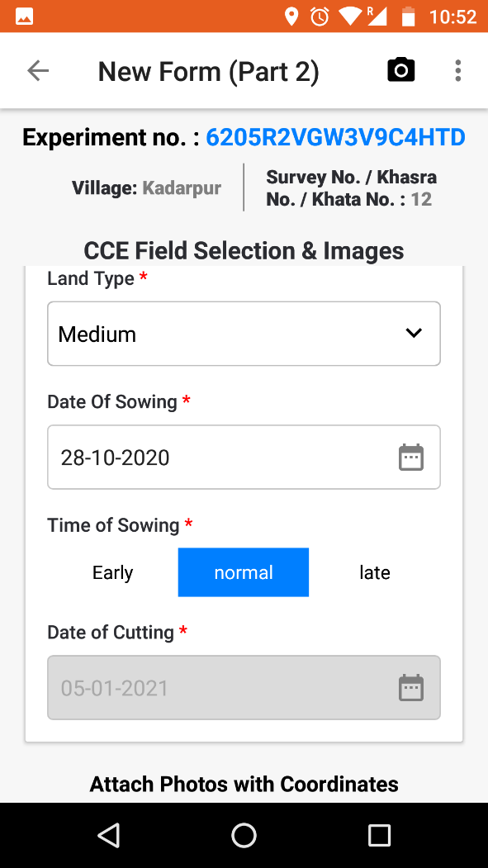


Filling of Part 2 (Form 2)- CCE Field selection
CCE AREA
WEIGHING OPERTION
Fill up the CCE field details and upload image.

Slide 34




Filling of Part 2 (Form 2)- Crop Specification
Fill up Crop Specification details and upload image and save.

Slide 35




Filling of Part 2 (Form 2)- Harvest & Weighing Specification
Enter the details of Harvest & Weighing Specification of form 2 and select the “dried & harvested at”.
If "Driage" is set to "Yes," the user must enter the "Driage Ratio".

Slide 36




Filling of Part 2 (Form 2)- Harvest & Weighing Specification
Click on the “YES” button if the IC co observer is present and the enter validation number provided by him, otherwise click on “NO” along with reason.

Slide 37


Filling of Part 2 (Form 2)- Harvest & Weighing Specification
Upload the image of weighing operations ( Digits of weight should be clearly visible in image )

Slide 38




Filling of Part 2 (Form 2)- Harvest & Weighing Specification
WEIGHING OPERTION
FORM-2/T-2 YIELD DATA
Enter the FYM, Chemical Fertilizer Used, select the Water Source upload the image and save the form.

Slide 39




Filling of Part 2 (Form 2)- Approval/Verification
Fill up the Approval/Verification details and save

Slide 40




Filling of Part 3 (Form 2)
After filling all the information click on Submit Form. The form will be uploaded immediately if internet is available at the time of Submission, or it will be Synchronized later when the internet connection is available
Enter the details of form 3 and click on Submit form

Slide 41




Submit Saved Forms
For Submitting Saved Forms Click on Saved Forms then select Form-2 and click on Next.

Slide 42


Submit Saved Forms
Click on Submit Form

Slide 43

View Personal Statistics
If the internet connectivity is unstable during Part 1 or Part 2 of data entry, you can synchronize the data once the connection is available.
To do this, click on the top left corner, go to "Personal Statistics," and if you have any pending data for synchronization, proceed to sync it.

Slide 44
Co – Observer App

Slide 45


Login to App and Co-observe CCE

Slide 46



Filling of Experiment Number
Enter the Experiment Number. If user is not present at field, then user have to enter the reason not for attending the CCE.

Slide 47





Generation of Validation Number
Click on “Generate Validation Number” and share the same with the primary CCE user for validation. Upload the photograph, enter the weights

Slide 48


Filling of Green weight, Dry weight and Objection if any
if user wants to object the experiment, then select the “Yes” Button, Select one objection reason from drop down and if “NO” then click of Submit.

Slide 49


View Profile and Sync Master Data

Slide 50
District CCE User Role (Approve / Reject)

Slide 51

District CCE User Role (Approve / Reject)
District CCE user can approve/reject/download the submitted CCE list, Part-1 completed forms, rejected CCE forms and approved CCE forms under CCE

Slide 52
District CCE User Role (Approve / Reject)
District CCE user have to Approve or Reject the submitted CCEs by clicking on List of part 2 completed forms.

Slide 53


District CCE User Role (Approve / Reject)
After checking of all the CCE data filled by primary worker, if all the details are correct then District CCE user can Approve the CCE experiment.

Slide 54
District CCE User Role (Approve / Reject)
After checking of all the CCE data filled by primary worker, if the CCE details are not correct and the CCE experiment has not supposed to approve then District CCE user can Reject the CCE experiment.

Slide 55

District CCE User Role (Approve / Reject)
District CCE user must write a reason of rejection and click on Submit. The CCE experiment will be rejected and it will be seen under Rejected CCE Forms.

Slide 56
District CCE User Role (Approve / Reject)
District CCE user can View/Download the list of rejected CCEs under the heading of Rejected and Approved CCE Form

Slide 57
CCE Report

Slide 58

CCE Report
District CCE user can view and generate the CCE reports under Report Section. Click on Report to View/ Generate the CCE report.
Select the CCE_COMPLETE_REPORT then click on Generate Report for the detailed CCE report, the detailed CCE report will be generated.

Slide 59

Sample Reports

Slide 60
State wise status of Planned CCEs and CCEs uploaded using CCE Agri app during the Season Kharif 2023 and 2024

Slide 61
State wise status of Planned CCEs and CCEs uploaded using CCE Agri app during the Season Kharif 2023 and 2024
Sl No | Name of the State UT | Expected CCE | CCE Conducted by App (2023) | CCE Conducted by App (2024) | % Achieved Kharif 2024
1 | Rajasthan | 135768 | 110351 | 119368 | 88
2 | Uttar Pradesh | 291640 | 102011 | 252279 | 87
3 | Uttarakhand | 4790 | 9131 | 2656 | 55
4 | Assam | 17164 | 12631 | 9505 | 55
5 | Meghalaya | 1072 | 817 | 489 | 46
6 | Tamil Nadu | 57292 | 0 | 22438 | 39
7 | Chhattisgarh | 135166 | 68260 | 47579 | 35
8 | Maharashtra | 124186 | 56608 | 41021 | 33
9 | Andhra Pradesh | 75000 | 28996 | 21839 | 29
10 | Jammu And Kashmir | 11008 | 2553 | 3073 | 28
11 | Odisha | 72904 | 22300 | 17314 | 24
12 | Puducherry | 480 | 78 | 99 | 21
13 | Haryana | 113048 | 15405 | 14985 | 13
14 | Tripura | 4384 | 994 | 546 | 12
15 | Jharkhand | 21596 | 0 | 1944 | 9
16 | Goa | 2700 | 229 | 160 | 6
17 | Manipur | 2272 | 0 | 82 | 4
18 | Sikkim | 7884 | 0 | 96 | 1
19 | Himachal Pradesh | 3632 | 585 | 29 | 1
20 | Madhya Pradesh | 1176 | 0 | 1 | 0
21 | Andaman & Nicobar | 792 | 0 | 0 | 0
 | Grand Total | 1083954 | 430949 | 555503 | 51

Slide 62

Thank You

